Slide 1

Lab 4
LIDAR
This lecture is part of the RACECAR-MN introductory robotics course. You can visit the course webpage at mitll-racecar-mn.readthedocs.io.

Slide 2
Objectives
Main Objective: Use LIDAR to detect objects around the car in all directions
Learning Objectives
Compare the advantages of the depth camera and the LIDAR, and identify ideal situations for each sensor
Convert raw LIDAR data into meaningful information about the surrounding environment
Understand and implement rudimentary path planning

Slide 3

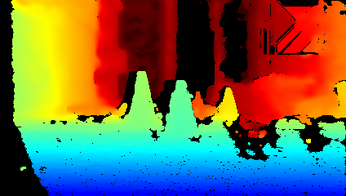
Depth Camera
Group activity
What are some limitations of depth cameras?

Slide 4
Depth Camera
Group activity
What are some limitations of depth cameras?
Can only see in front of the car
Do not work in the dark/poor lighting
Noise and missing data

Slide 5
Depth Camera
Group activity
What are some limitations of depth cameras?
Can only see in front of the car
Do not work in the dark/poor lighting
Noise and missing data
On the other hand, LIDAR:
Provides 360-degree vision
Works in all lighting environments
Can provide a second source of truth

Slide 6
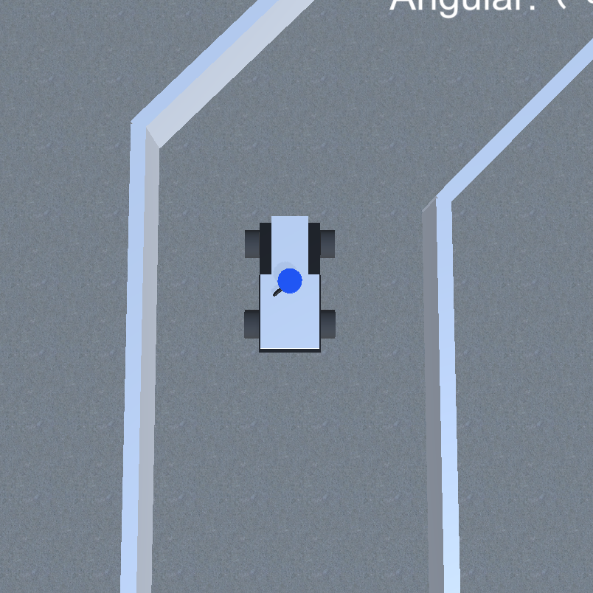
Depth Camera
Group activity
Depth camera field of view = 74 degrees

Slide 7
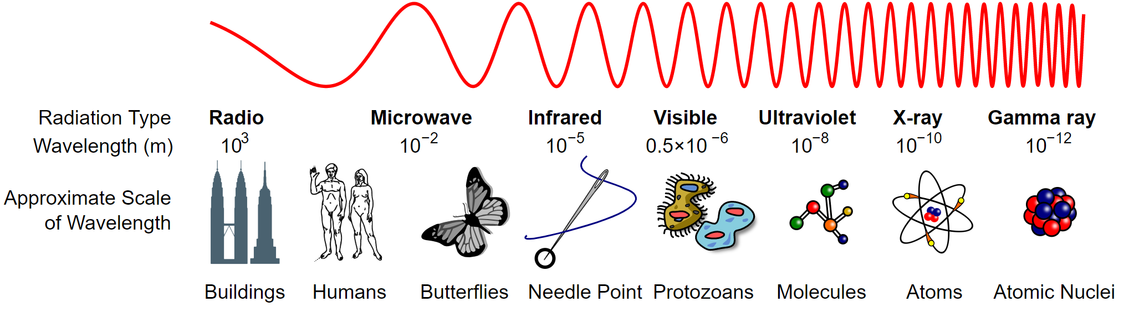
LIDAR
Group activity
LIDAR (light + radar): Calculate object distance by firing a laser and measuring the time it takes to return
Like radar but with a smaller wavelength of light
radar
RACECAR
LIDAR
LIDAR

Slide 8
LIDAR
Animation created by Mike1024

Slide 9
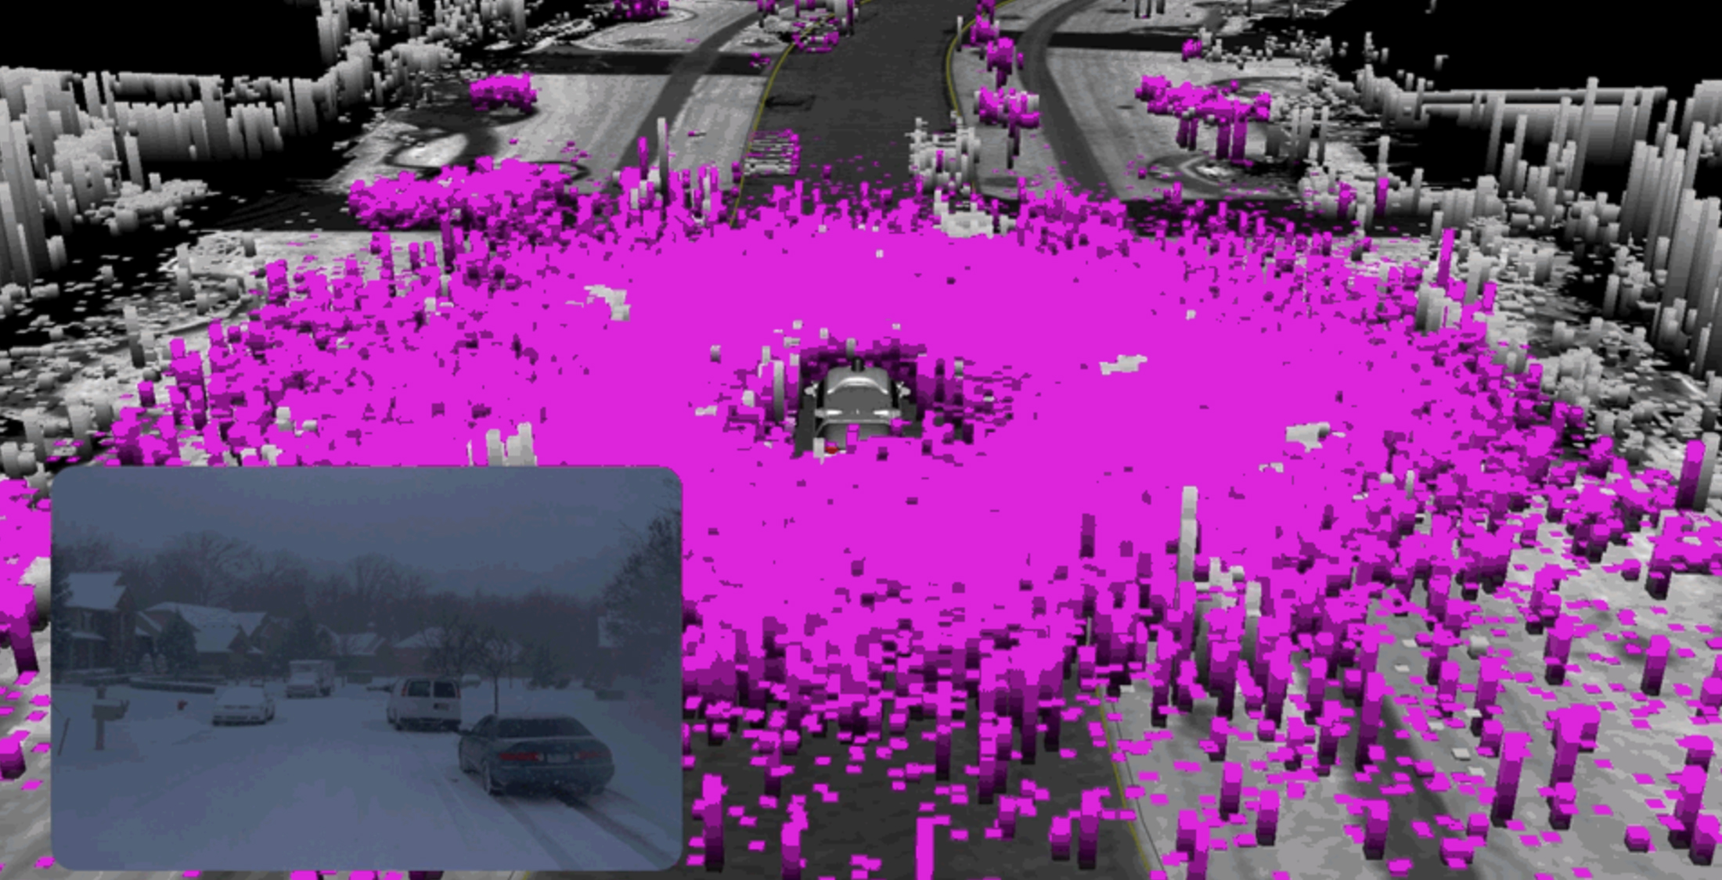
LIDAR Limitations
Group activity
Accuracy varies based on material
Subject to noise and null values
Poor performance in snow

Slide 10
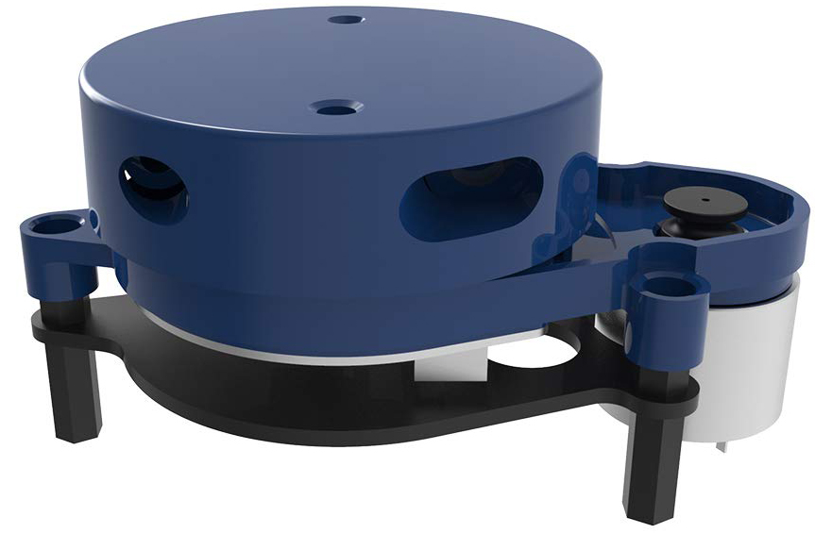
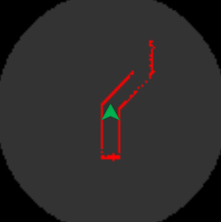
RACECAR-MN LIDAR
YDLIDAR X4 (2D)
$100 (cheap for LIDAR)
Max range: 10 m
Between 6 to 12 hz
720 samples returned as an array of floats
0th entry = directly in front of the car
Ordered clockwise

Slide 11
Lidar Module
Retrieves the LIDAR scan
Public interface
get_samples()
get_num_samples()
Notes:
https://mitll-racecar.readthedocs.io/en/latest/camera.html

Slide 12
Display Module
Displays data and images to the screen
Simulation: Creates a window on your computer
RACECAR: Creates a window on the mini-monitor
Public interface
show_color_image()
show_depth_image()
show_lidar()
Notes:
https://mitll-racecar.readthedocs.io/en/latest/display.html

Slide 13
Examples
Group activity
# Example 1
scan = rc.lidar.get_samples()
foo = scan[450]
# Example 2
scan = rc.lidar.get_samples()
scan = (scan - 0.01) % 100000
bar = np.argmin(scan) * 360 / rc.lidar.get_num_samples()
# Example 3
scan = rc.lidar.get_samples()
baz = [e for e in scan[170:191] if e > 0.0]
qux = sum(baz) / len(baz)

Slide 14
Examples
Group activity
# Example 1
scan = rc.lidar.get_samples()
foo = scan[450]
# Example 2
scan = rc.lidar.get_samples()
scan = (scan - 0.01) % 100000
bar = np.argmin(scan) * 360 / rc.lidar.get_num_samples()
# Example 3
scan = rc.lidar.get_samples()
baz = [e for e in scan[170:191] if e > 0.0]
qux = sum(baz) / len(baz)
when would this cause an error?

Slide 15
Lab 5 Objectives
Jupyter Notebook: Write helper functions to measure average distance and find the closest point in a scan
Lab 5A: Safety stop (revisited)
Lab 5B: Wall following
Revisit Phase 1 challenge

